Slide 1
Let's Build! 🛠️
OpenClaw for Office Managers — Day 2: Hands-On Labs
6 Hours · 4 Labs · 1 Capstone · Zero to Automated
1 / 15
Notes:
Welcome back to Day 2!

Slide 2
Today's Roadmap
0:00–0:30 Lab 0: Setup Check
0:30–1:30 Lab 1: Connect a Channel (Slack/Teams)
1:30–2:45 Lab 2: Cron-Based Report Generator
2:45–3:00 ☕ Break
3:00–4:00 Lab 3: Email Triage Skill
4:00–4:15 ☕ Break
4:15–5:15 Lab 4: Webhook-Driven Document Workflow
5:15–6:00 Capstone Project & Showcase
2 / 15
Notes:
Today's schedule. Two breaks built in.

Slide 3
Lab 0: Setup Checklist ✅
1. Run: openclaw --version
2. Run: openclaw onboard (if not done)
3. Test: openclaw message send 'Hello'
4. Check: ~/.openclaw/workspace/ exists
5. Verify: API key configured
Need help? Raise your hand.
3 / 15
Notes:
Walk around and help everyone get set up.

Slide 4
Lab 1: Connect a Channel
Goal: Connect OpenClaw to Slack or Teams and send your first automated message
Time: 60 minutes
You'll learn: Channel configuration, bot tokens, gateway restart
Deliverable: Bot responds when you message it
4 / 15
Notes:
Lab 1 is about connecting a channel.

Slide 5
Lab 1: Step-by-Step
Step 1: Create Slack App at api.slack.com → Get Bot Token
Step 2: Open ~/.openclaw/workspace/gateway.yaml
Step 3: Add Slack config under 'channels' section
Step 4: Run: openclaw gateway restart
Step 5: Send a message to your bot in Slack
Step 6: Verify the bot responds!
channels:
slack:
enabled: true
bot_token: "xoxb-your-token-here"
5 / 15
Notes:
Slack app creation is the trickiest part. Add scopes: chat:write, channels:history, app_mentions:read.

Slide 6
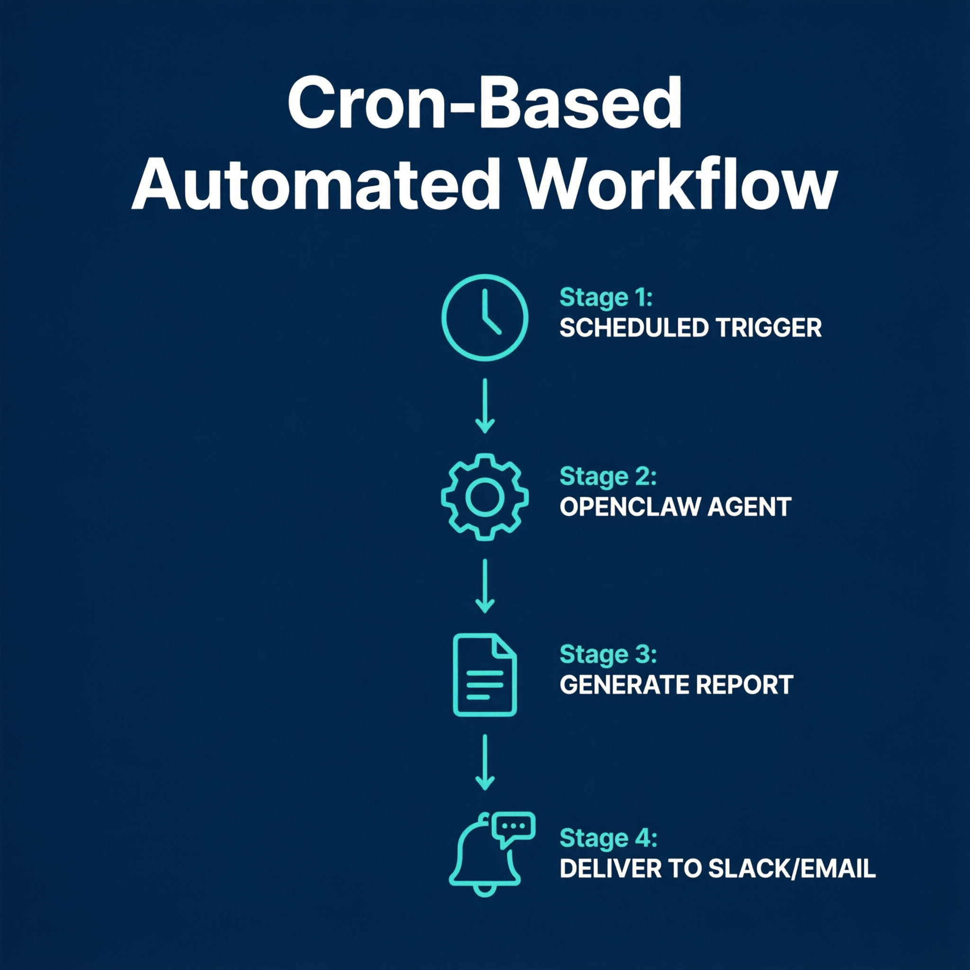
Lab 2: Cron-Based Report Generator
Goal: Create a scheduled task that compiles data and sends a summary daily
Time: 75 minutes
You'll learn: Cron syntax, skill creation, scheduled triggers
Deliverable: Automated daily report arrives in Slack
6 / 15
Notes:
Lab 2: cron-based report. Most impactful for office managers.

Slide 7
Lab 2: Step-by-Step
Step 1: Create: ~/.openclaw/workspace/skills/daily-report/
Step 2: Write SKILL.md with report instructions
Step 3: Add cron entry in gateway.yaml
Step 4: Test: openclaw cron run 'Daily Report'
Step 5: Verify output in Slack
cron:
- name: "Daily Report"
schedule: "0 9 * * 1-5" # 9 AM, Mon-Fri
agent: "main"
message: "Generate the daily sales summary report"
7 / 15
Notes:
SKILL.md should instruct AI to read CSV and format summary.

Slide 8
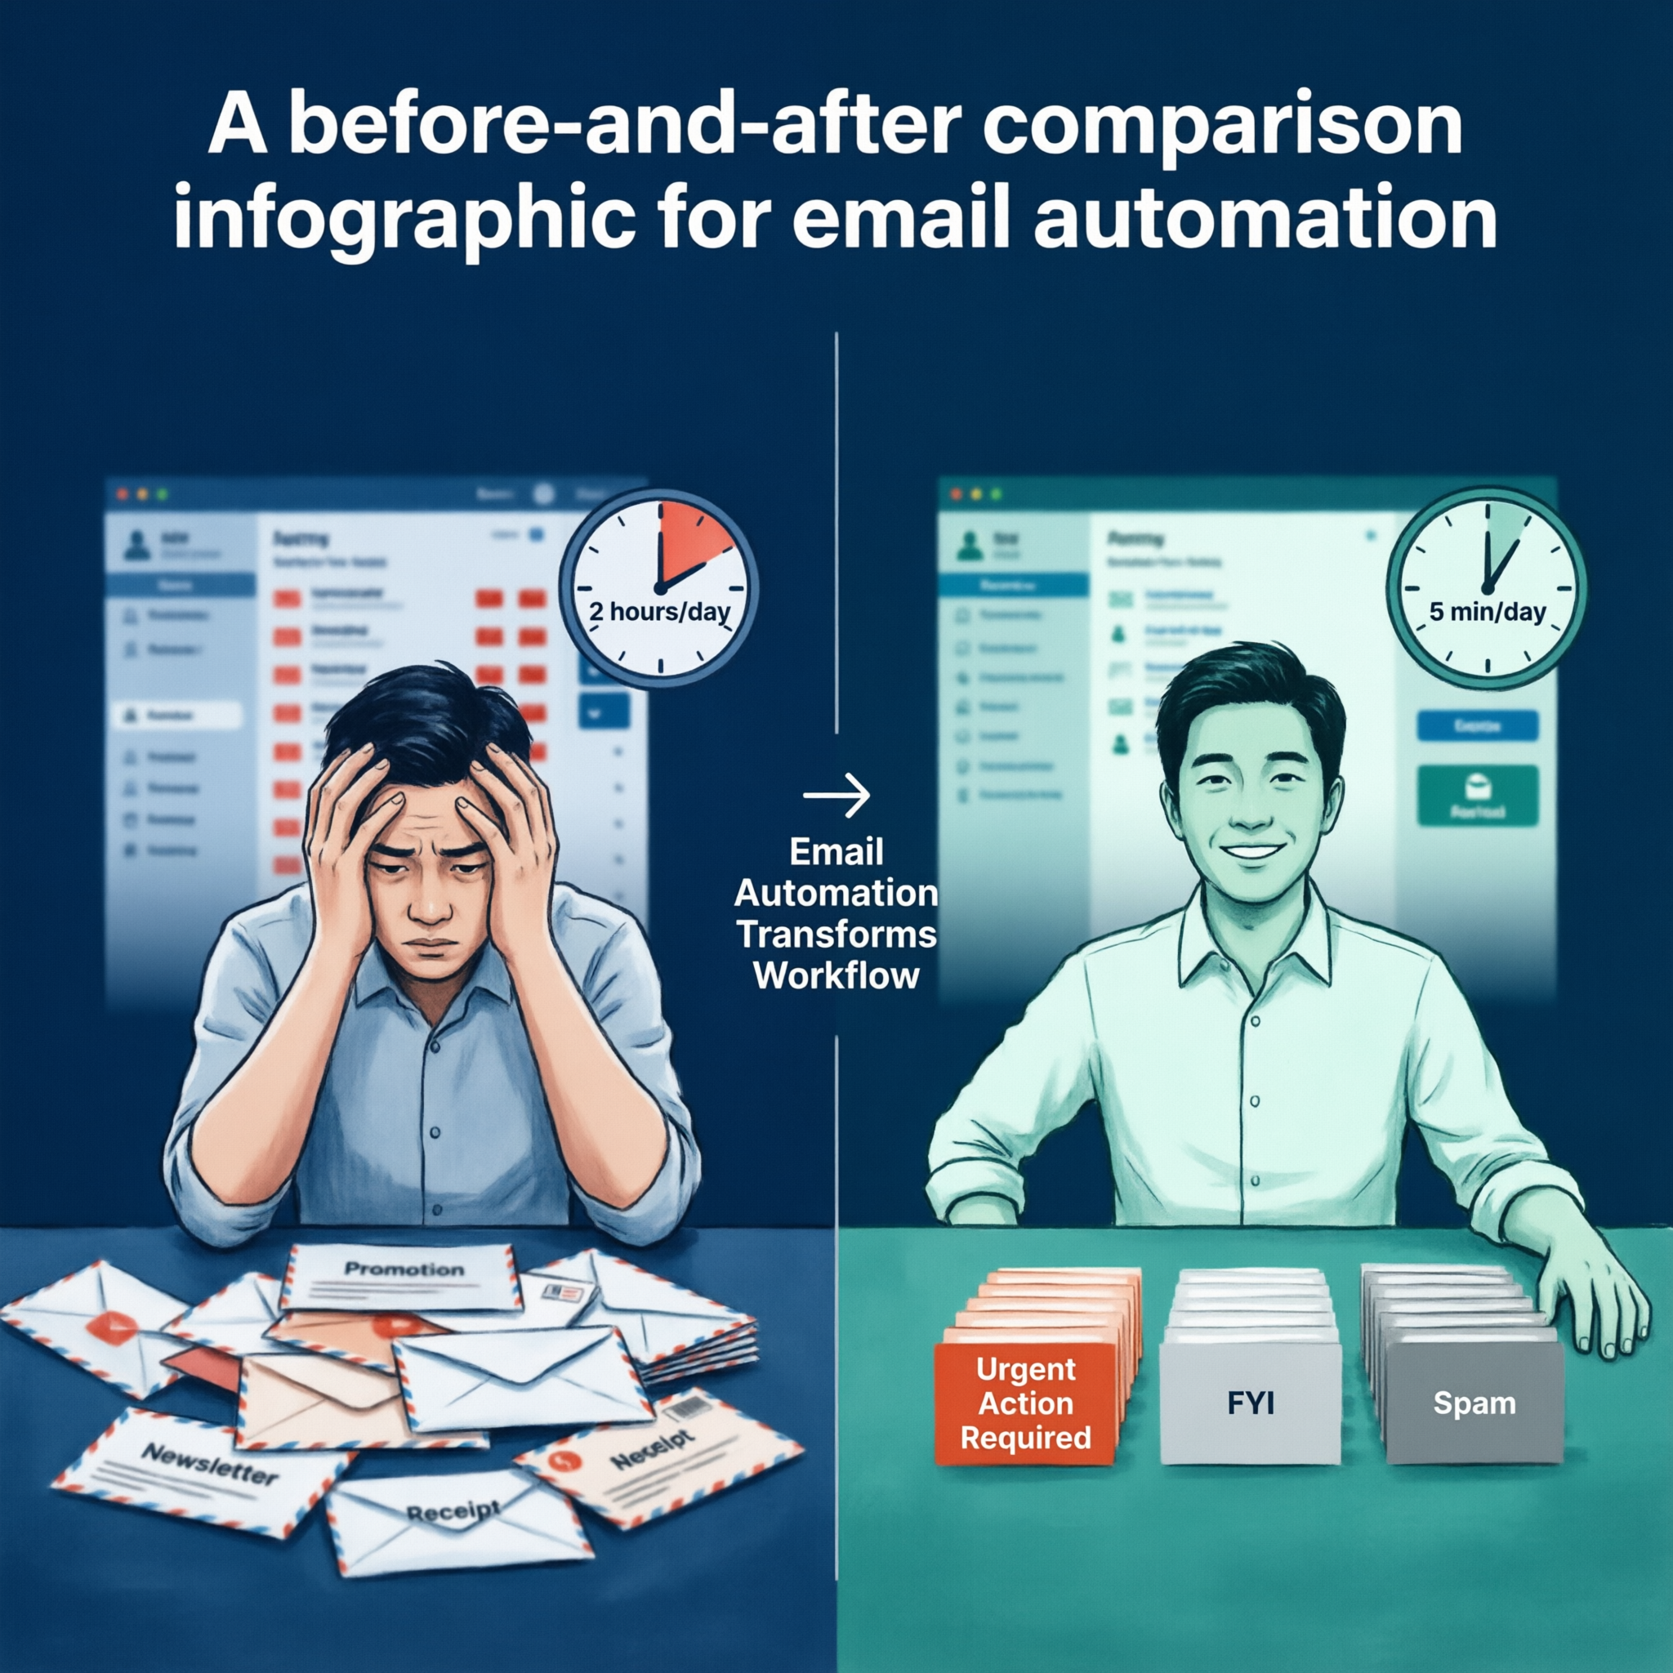
Lab 3: Email Triage Skill
Goal: Build a custom skill that categorizes and auto-responds to emails
Time: 60 minutes
You'll learn: Custom skill writing, classification logic, draft responses
Deliverable: Working email triage with your own categories
8 / 15
Notes:
Lab 3: write your own skill. Categories should be custom to each person's role.

Slide 9
Lab 3: Step-by-Step
Step 1: Create: ~/.openclaw/workspace/skills/email-triage/SKILL.md
Step 2: Define your categories (Urgent, Action, FYI, Spam)
Step 3: Write classification rules in plain English
Step 4: Add draft response template for each category
Step 5: Test with 5 sample emails
Step 6: Customize categories for YOUR workflow
9 / 15
Notes:
Emphasize custom categories. HR's 'Urgent' differs from finance's 'Urgent'.

Slide 10
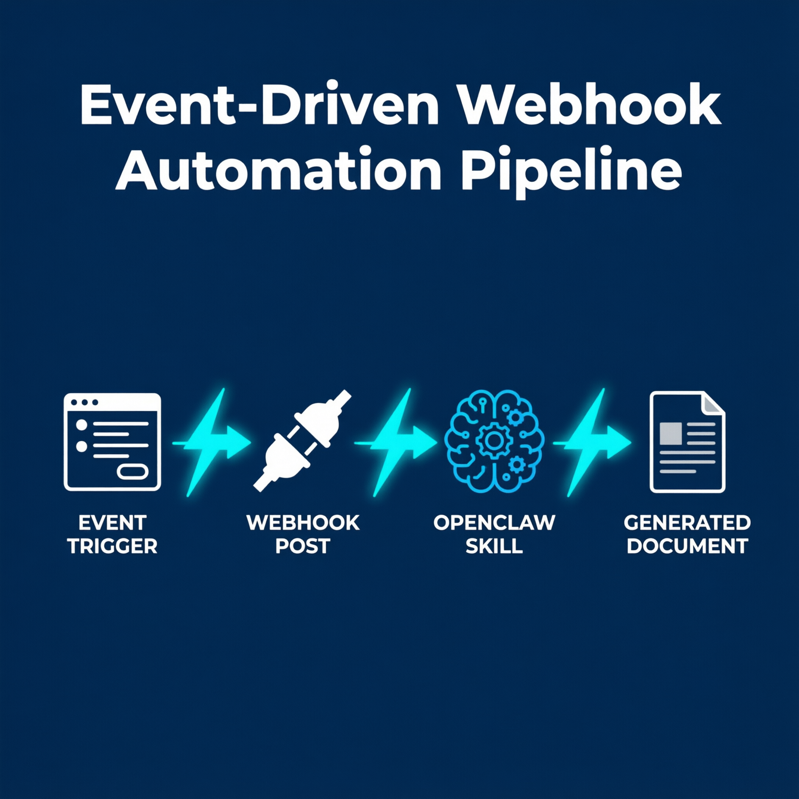
Lab 4: Webhook-Driven Document Workflow
Goal: Trigger document generation from a webhook (form → auto-report)
Time: 60 minutes
You'll learn: Webhook config, event-driven triggers, document generation
Deliverable: Webhook-triggered report generation
10 / 15
Notes:
Lab 4: most advanced — webhook-driven document generation.

Slide 11
Lab 4: Step-by-Step
Step 1: Enable webhooks in gateway.yaml
Step 2: Create a skill that responds to /report-request
Step 3: Test with curl command
Step 4: Verify generated report output
Step 5: Optional — connect to Google Forms or Typeform
curl -X POST http://localhost:3000/report-request \
-H "Content-Type: application/json" \
-d '{"topic": "Q1 Sales", "date": "2026-03-31"}'
11 / 15
Notes:
If people aren't comfortable with terminal, show Postman as alternative.

Slide 12
🏆 Capstone: Build Your Own Automation
Pick ONE real task from your daily work and automate it
1. Identify: What task wastes your time?
2. Design: Trigger → Action → Output
3. Build: Use patterns from Labs 1-4
4. Share: 2-minute demo to the group
45 minutes build + 15 minutes showcase
12 / 15
Notes:
Capstone time! 45 minutes to build, 2 minutes each to present.

Slide 13
Troubleshooting Tips 🔧
Gateway not starting? → Check: openclaw gateway status
Slack bot not responding? → Verify bot is invited to channel
Cron not firing? → Check timezone in gateway.yaml
Webhook 404? → Confirm path matches in config and curl
Skill not loading? → File must be named SKILL.md exactly
API errors? → Verify your key has sufficient quota/credits
13 / 15
Notes:
Keep this slide up during labs. Walk around proactively.

Slide 14
Resources & Next Steps 📚
📖 Documentation: github.com/openclaw/openclaw
🦞 ClawHub Registry: 5,400+ community skills
💬 Community: Discord server for support
📧 Newsletter: Stay updated on new features
🔧 Next: More channels, chain skills, add voice
Start small: automate one new task every week.
14 / 15
Notes:
Point to documentation and community.

Slide 15
Thank You! 🙏
Now go automate something!
Scan the QR code to share your feedback
[ QR Code Placeholder ]
15 / 15
Notes:
Thank everyone. Remind to scan feedback QR.

