Slide 1
Automate Your Office with AI
OpenClaw for Office Managers — Day 1: Theory & Concepts
🦞 Open Source · Local-First · No-Code Friendly
1 / 20
Notes:
Welcome everyone! Today is Day 1 — we'll cover the theory behind office automation and introduce OpenClaw.

Slide 2
Today's Agenda
Module 1: What is Office Automation? (30 min)
Module 2: Introduction to OpenClaw (30 min)
☕ Break (15 min)
Module 3: Core Capabilities — Live Demo (45 min)
Module 4: Skills & Automation Patterns (30 min)
Q&A + Lab Prep (15 min)
2 / 20
Notes:
Here's our roadmap for the day.

Slide 3
🤔 What repetitive task wastes your time every week?
Turn to someone next to you — share your #1 time-waster
"I spend 2 hours every Monday compiling reports"
"I manually forward the same emails to different people"
"I keep drafting the same type of document from scratch"
3 / 20
Notes:
Icebreaker: Have people pair up and share.

Slide 4
What is Office Automation?
Technology to perform repetitive office tasks without manual effort
Evolution: Macros → RPA → Scripts → AI Agents (OpenClaw)
AI agents understand natural language — no code needed
Today's office manager doesn't need to be a programmer to automate.
4 / 20
Notes:
Walk through the evolution of automation tools.

Slide 5
Why AI Agents Change Everything
No-code: Describe what you want in plain language
Multi-app: Connect Slack, email, calendar, files in one workflow
Adaptive: Learns from corrections and improves over time
Always-on: Runs 24/7 on your own machine — no SaaS fees
Old RPA took weeks. OpenClaw takes minutes.
5 / 20
Notes:
Emphasize contrast with traditional RPA tools.

Slide 6
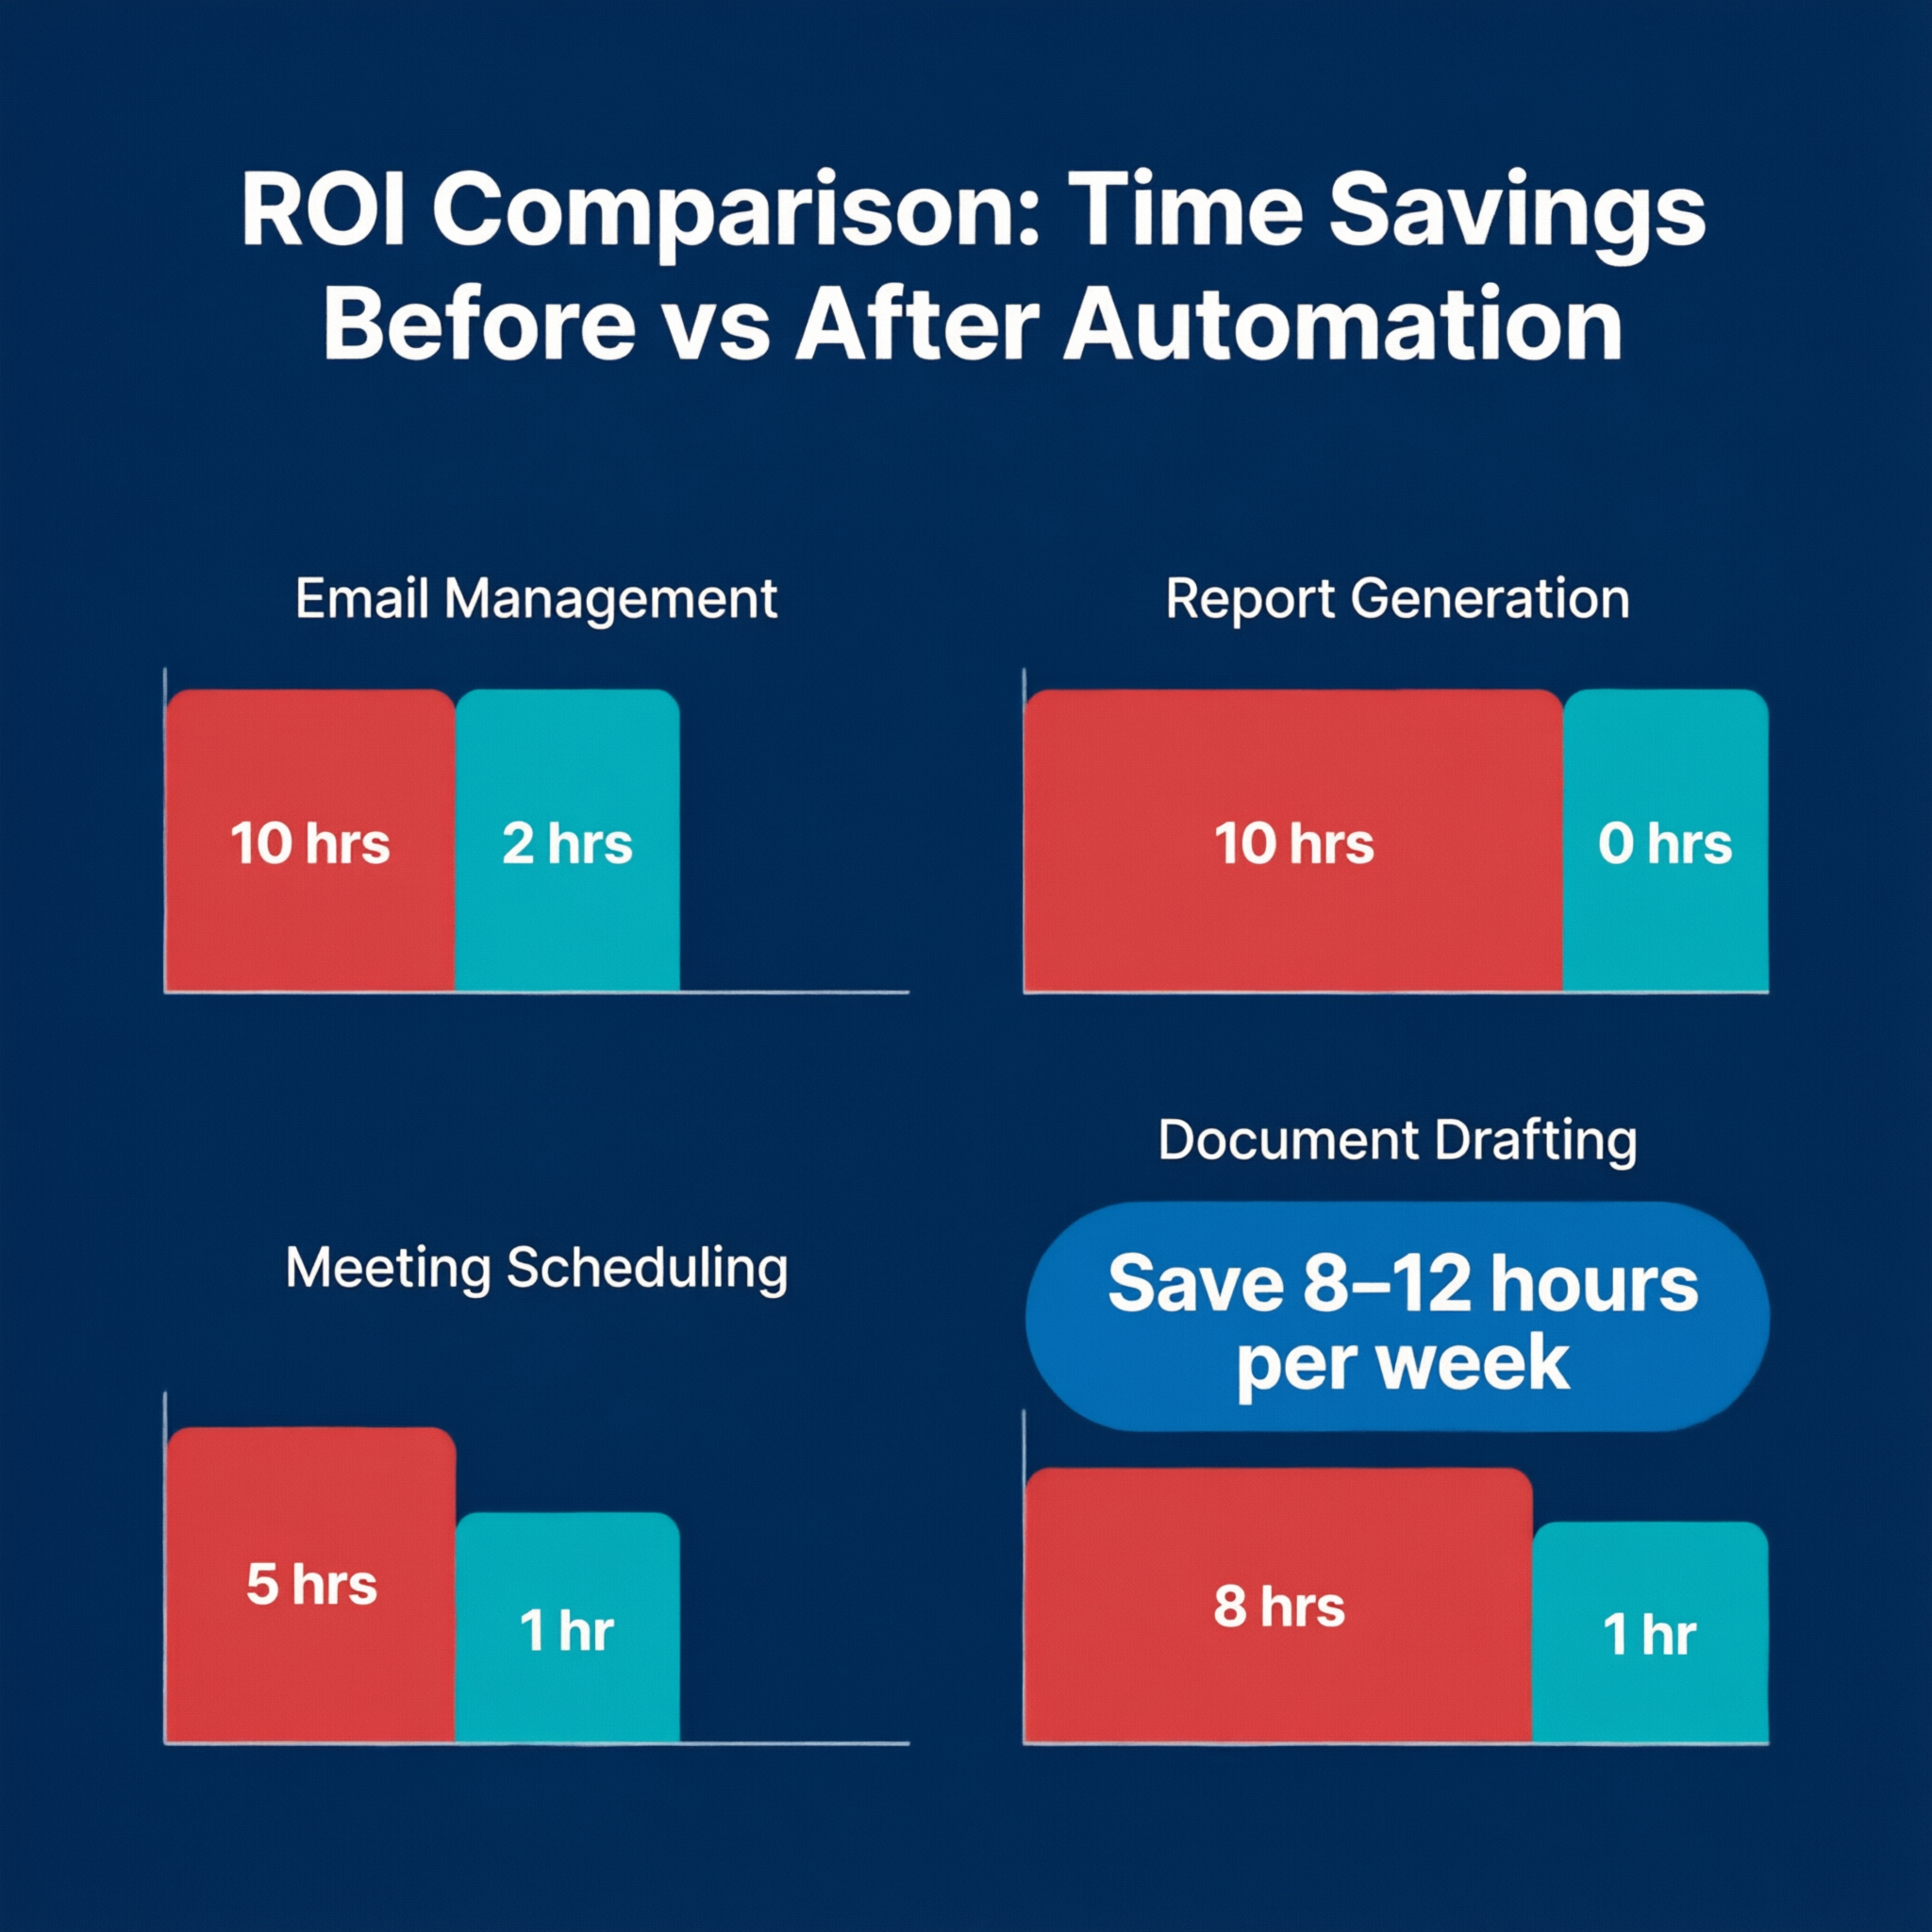
Real ROI Examples
📧 Save 5 hrs/week on email triage
📊 2 hrs/day → 0 (fully automated)
📅 Eliminate 30+ scheduling emails/week
📄 60-sec draft vs. 30-min from scratch
8-12 hours saved per week per person
6 / 20
Notes:
Walk through the ROI stats. The chart on the right shows before/after comparison.

Slide 7
Meet OpenClaw 🦞
Your own personal AI assistant — Any OS, Any Platform
Open-source (GitHub: openclaw/openclaw)
Local-first — your data stays yours
Multi-channel: Slack, Teams, WhatsApp, Gmail & more
Built-in: Cron jobs, webhooks, skills system
One command: npm install -g openclaw
7 / 20
Notes:
OpenClaw is open-source, runs locally, no data leaves your machine.

Slide 8
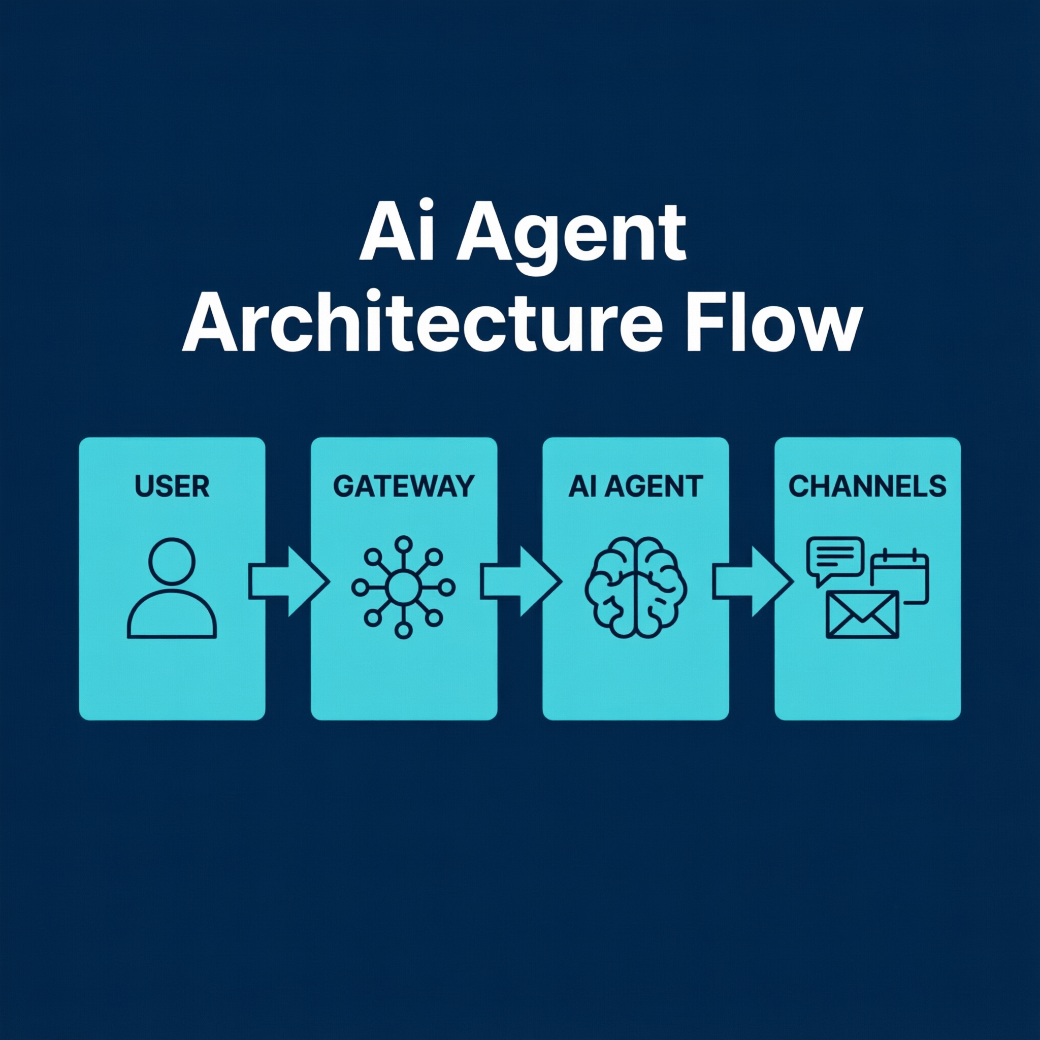
How OpenClaw Works
You send a message (Slack, Teams, CLI, etc.)
Gateway receives and routes it
AI agent reads your SKILL.md instructions
Agent executes tools (files, browser, cron, webhooks)
Response sent back to your channel
Workspace: ~/.openclaw/workspace/
8 / 20
Notes:
Walk through the architecture diagram on the right: User → Gateway → Agent → Channels.

Slide 9
Why Local-First Matters
🔒 Your data never leaves your machine unless you configure it
💰 No per-user monthly SaaS fees
🔧 Full control — modify, extend, disable anything
📡 Works offline for local automations
🏢 IT-friendly — deploy on-premise behind firewalls
9 / 20
Notes:
Key differentiator: runs locally, important for compliance.

Slide 10
Channels: Where It Connects
💬 Slack
💬 Microsoft Teams
💬 Discord
💬 WhatsApp
💬 Telegram
💬 Signal
📧 Gmail
💬 Google Chat
💬 iMessage
💬 IRC
🌐 WebChat
💬 +15 more...
Tomorrow: Connect to Slack or Teams in Lab 1
10 / 20
Notes:
20+ channels. We'll focus on Slack/Teams.

Slide 11
Skills: The Building Blocks
A Skill = a Markdown file (SKILL.md) telling AI what to do
Stored in: ~/.openclaw/workspace/skills/<name>/SKILL.md
5,400+ community skills on ClawHub registry
Write your own — describe behavior in plain English
# Email Triage — classify incoming emails When you receive an email: 1. Classify: Urgent / Action Required / FYI / Spam 2. Write a one-line summary 3. Draft a suggested response (if Action Required)
11 / 20
Notes:
Skills are the core concept — just a text file with instructions.

Slide 12
Cron Jobs: Automate on Schedule
Run any automation at a specific time
Standard cron syntax: minute hour day month weekday
Perfect for: daily reports, weekly digests, monthly summaries
# Daily report at 9 AM, Monday-Friday cron: - name: "Daily Sales Report" schedule: "0 9 * * 1-5" # 9 AM, Mon-Fri agent: "main" message: "Generate the daily sales summary report" # Weekly digest every Friday at 5 PM schedule: "0 17 * * 5" # 5 PM, Friday
12 / 20
Notes:
Cron is a Unix concept for scheduled tasks. The syntax is: minute hour day month weekday.

Slide 13
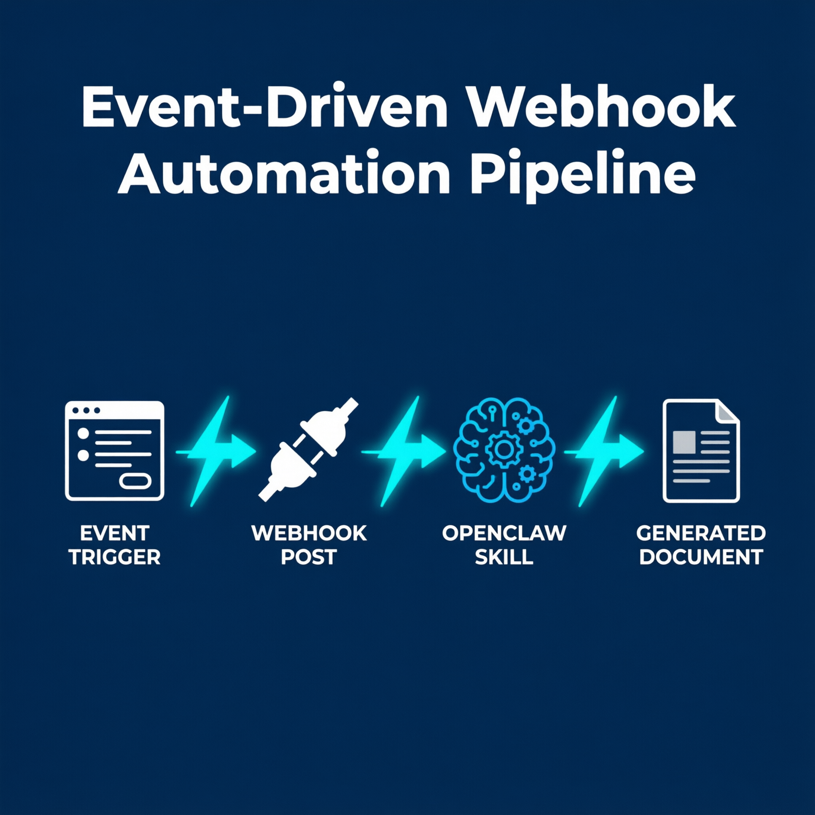
Webhooks: Automate on Event
Trigger automation when something happens externally
Examples: Form submitted → Generate report
Any app that sends POST can trigger a webhook
# Enable in gateway.yaml webhooks: - name: "Report Request" path: "/report-request" # Trigger from anywhere: curl -X POST localhost:3000/report-request \ -H "Content-Type: application/json" \ -d '{"topic":"Q1 Sales"}'
13 / 20
Notes:
Webhooks are event-driven triggers instead of scheduled.

Slide 14
🔴 Live Demo: OpenClaw + Slack
What we'll do right now:
1. Create a Slack app and get a bot token
2. Configure OpenClaw's gateway.yaml
3. Restart the gateway
4. Send a message to the bot in Slack
5. Watch it respond in real-time
14 / 20
Notes:
LIVE DEMO: Switch to terminal. Walk through the 5 steps.

Slide 15
🔴 Live Demo: Daily Report via Cron
What we'll do right now:
1. Create a 'daily-report' skill with a prompt
2. Add a cron entry in gateway.yaml
3. Test with: openclaw cron run 'Daily Report'
4. Watch the report arrive in Slack
15 / 20
Notes:
LIVE DEMO: Show skill creation, cron config, manual trigger.

Slide 16
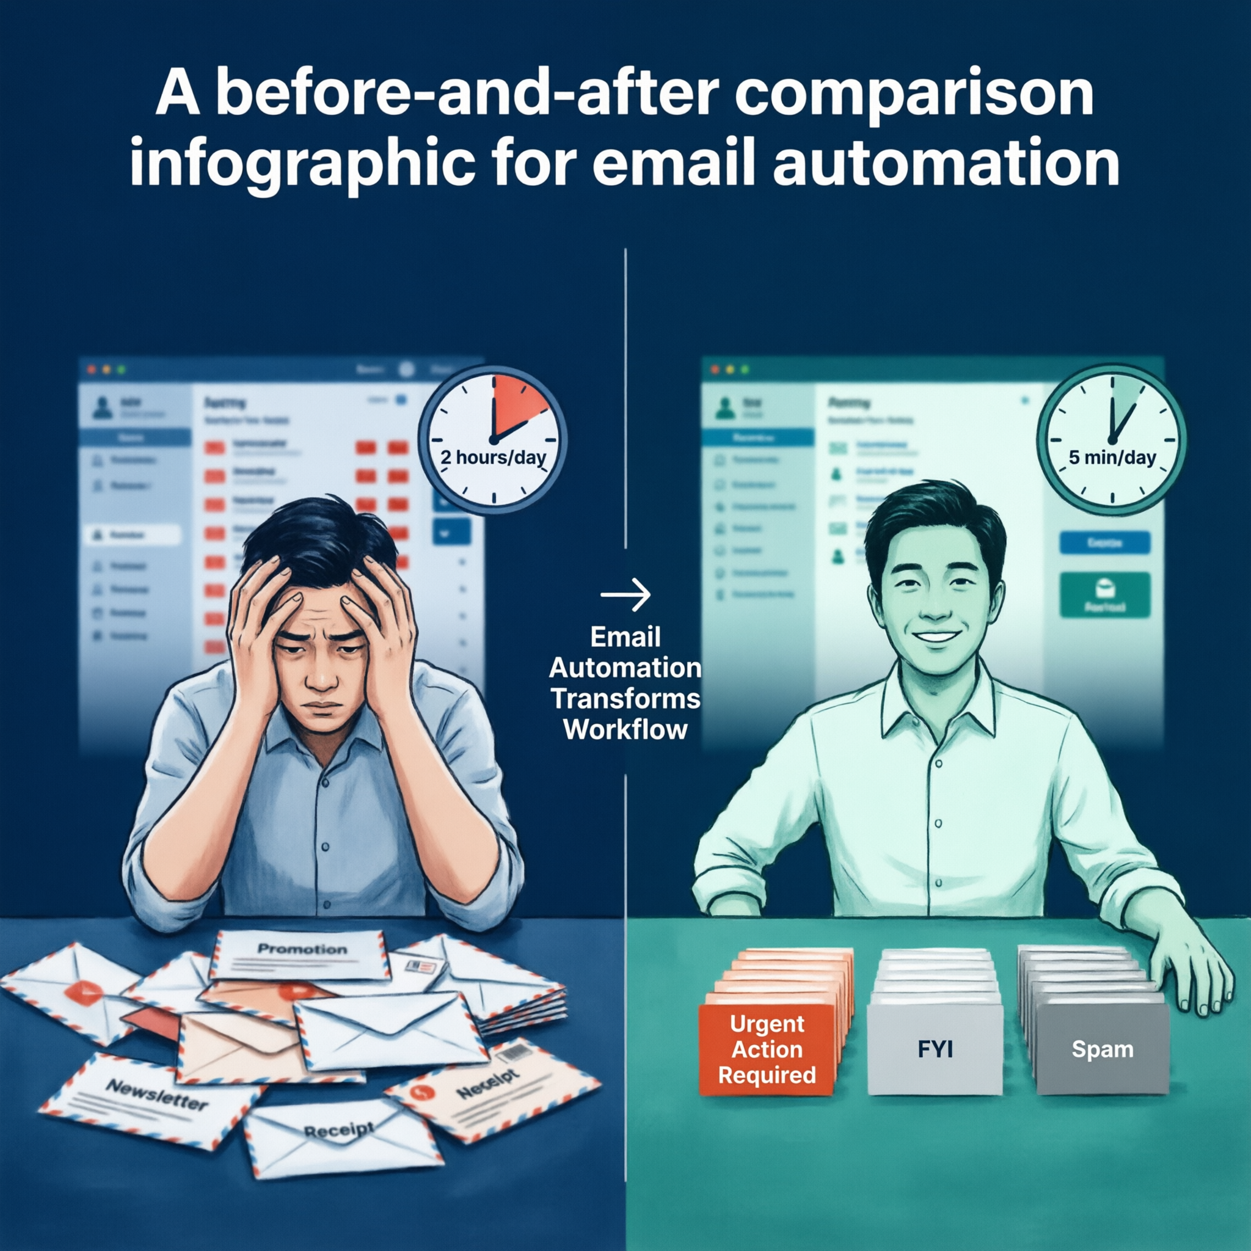
Use Case 1: Email Triage
BEFORE:
Manually read every email
Decide: respond, forward, archive, delete
Spend 1-2 hours/day on inbox
AFTER:
OpenClaw classifies every incoming email
Urgent → Slack notification
FYI → daily digest summary
Draft responses auto-prepared
~5 hours/week saved · Build in Lab 3
16 / 20
Notes:
Walk through before/after. Classification categories are custom to each person's role.

Slide 17
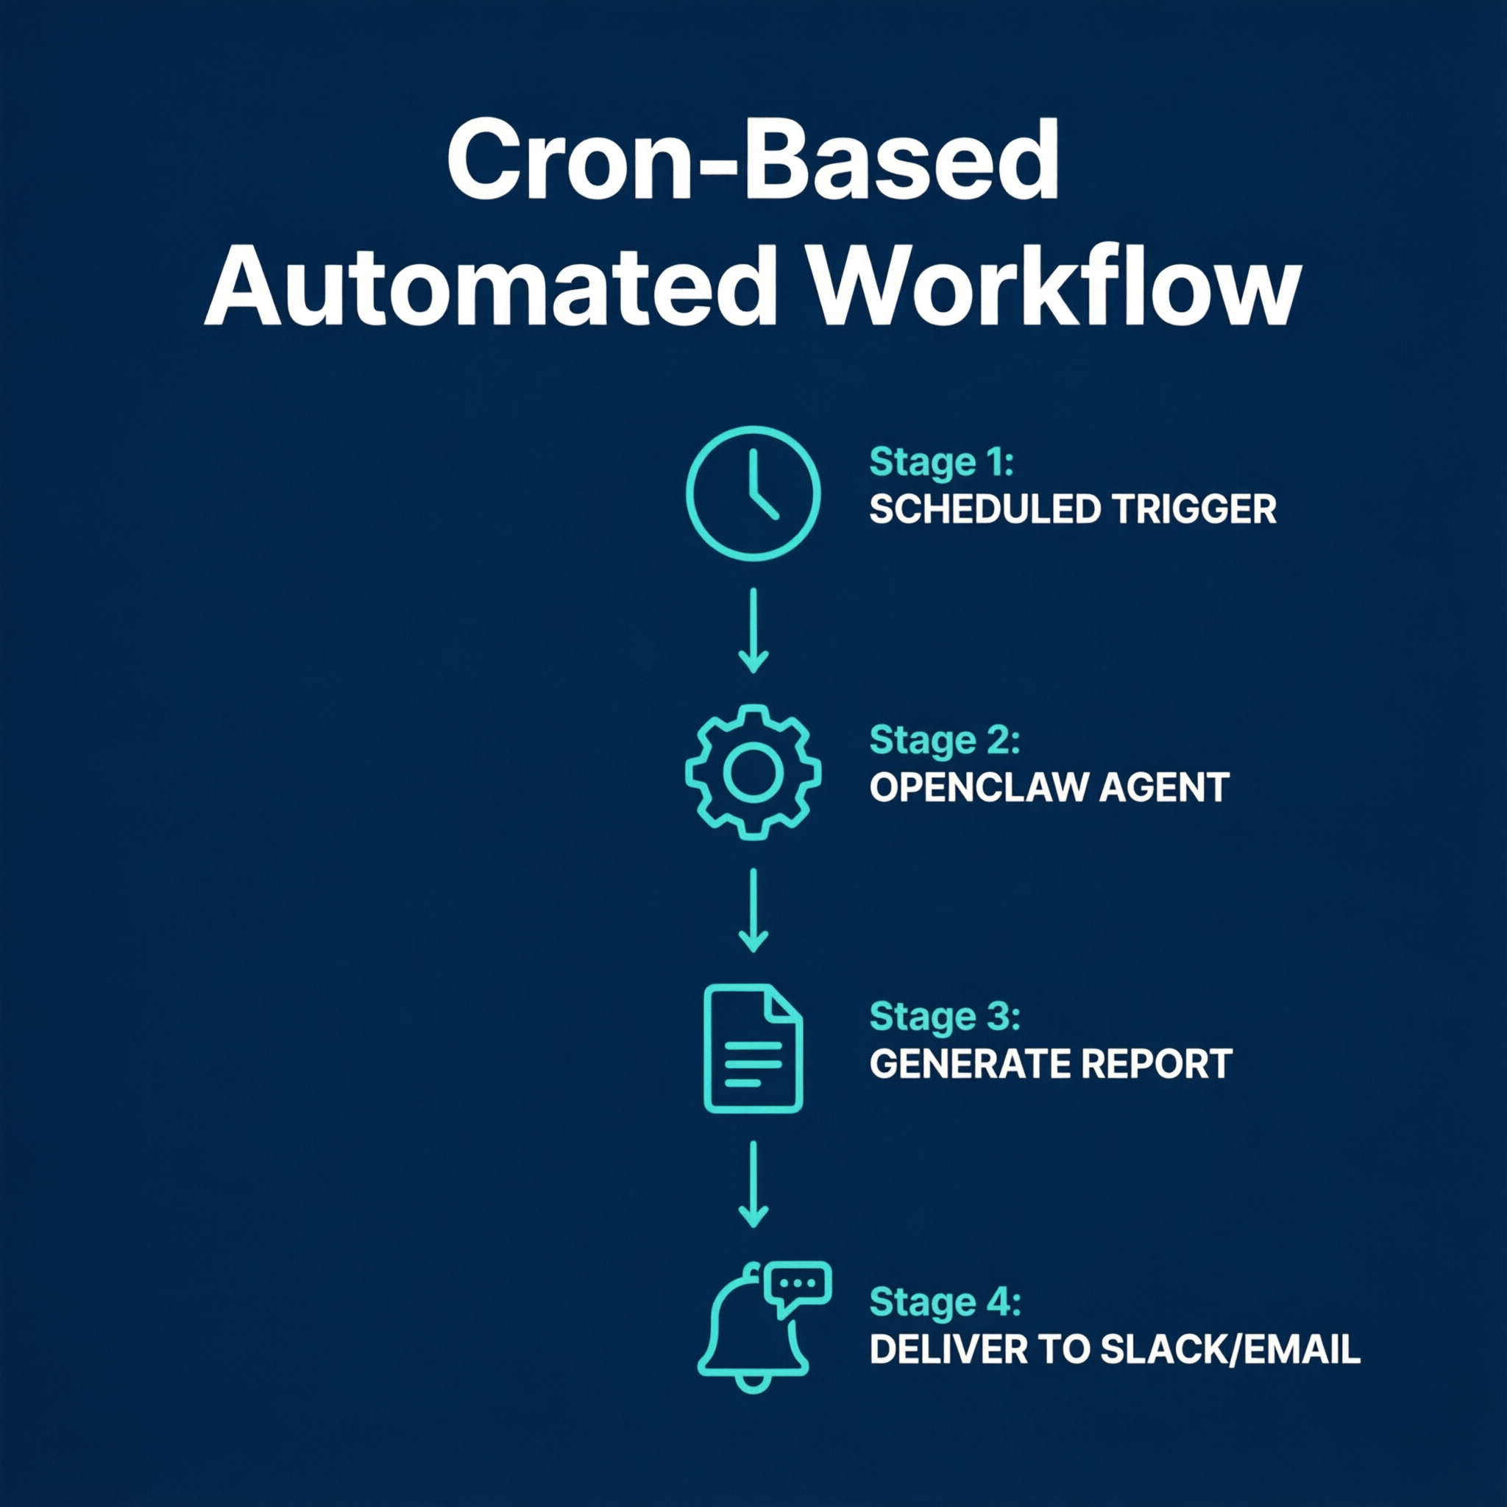
Use Case 2: Report Generator
📊 Data: CSV, Google Sheet, or database
↓
🤖 OpenClaw reads data, identifies trends, writes summary
↓
📤 Output: Slack message, email, or document
↓
⏰ Schedule: Every morning at 9 AM via cron
2 hrs/day saved · Build in Lab 2
17 / 20
Notes:
Cron-based report generator. Data source can be anything.

Slide 18
Use Case 3: Meeting Scheduler
Incoming request → OpenClaw checks your calendar
Finds available slots within your preferences
Sends suggested times back via Slack/email
Once confirmed, creates the calendar invite
Sends reminder 15 min before with agenda
Eliminates: 30+ back-and-forth emails per week
18 / 20
Notes:
Meeting scheduling is one of the most time-consuming admin tasks.

Slide 19
Use Case 4: Document Drafter
Trigger: Form submission, webhook, or Slack message
OpenClaw generates a first draft using your template
Output: Google Doc, Word file, or formatted message
You review and edit — never start from blank page
Draft in 60 seconds vs. 30 minutes from scratch
Examples: Meeting minutes, project updates, client proposals, status reports
19 / 20
Notes:
Never start from a blank page again.

Slide 20
Tomorrow: Hands-On Day 🚀
6 hours of building. 4 labs. 1 capstone project.
Lab 1: Connect OpenClaw to Slack or Teams
Lab 2: Build a cron-based daily report
Lab 3: Create a custom email triage skill
Lab 4: Set up webhook-driven document workflow
Capstone: Automate YOUR real work task
Bring your laptop, API key, and one real task!
20 / 20
Notes:
Wrap up Day 1. Remind everyone what to bring tomorrow.

